Slide 1
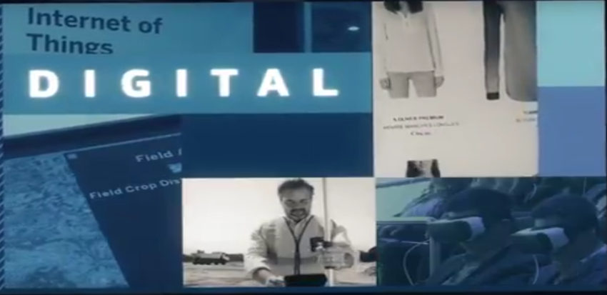
4th annual COCIR Digital Health Summit Digital Transformation of Health and Care: The Voice of Stakeholders Trust, cybersecurity and data protection: Challenges for healthcare industry in the digital transformation of health and care
Despina Spanou
Director for Digital Society, Trust & Cybersecurity
DG Communications Networks, Content and Technology (DG CONNECT)
European Commission

Slide 2

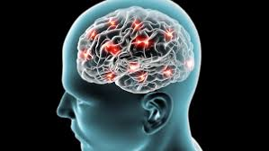
Mid-term review of the Digital Single Market
Digital Transformation of health and care
Citizen's secure access to and use of health data
Data infrastructure to advance research and personalised medicine
Citizen empowerement and patient-centred care
Data-driven innovation
New therapies and diagnostics
New health and care models
High-performance computing
Advanced Data-Analytics
Prevention and early risk detection
Artificial Intelligence
Cloud computing
Internet of Things (IoT)
Wearables
mHealth
Personalised Medicine
Telehealth
Notes:
CITIZENS-FIRST!
Citizens in Europe have the right to access their health data, and yet, in practice, most often this is not the case. Most citizens don't have electronic access to data about their own health, which is often scattered in different places and untraceable, which limits the potential in making Citizens better managers of their health and medical conditions.
DATA!
Secondly, there is an enormous potential in using health data to advance medical research and personalized medicine. However, integration of big data faces many problems related to cross border, technical and semantical interoperability and standards.
But we have an enormous potential that we're not yet seizing…If Europe coordinates and expands advanced data analytics capacity with High Performance Computing and Cloud infrastructure, and links national initiatives such as genomics databanks and biobanks, we can reach a larger cohort - and come closer to the scale that is needed to achieve real breakthroughs in personalised medicine and medical science.
If we don't – there is a risk that European initiatives will remain small-scale and available only to a limited number of Citizens / Member States, further contributing the digital divide between those Member States and Citizens with access to infrastructure, and those without.
PATIENT-CENTRED CARE!
Thirdly, we must promote a true European market for digital products and services on health and care that provides high Security and privacy standards and can empower the citizens and overcome the fragmentation that our innovators (start-ups and SMEs) often face when trying to scale up across borders.
For this, we must ensure that there is transfer of innovative practices across the EU (East and West, North and South), and that technical capacity building and EU-wide Cooperation is strengthened.
The Commission is actively engaged in all the issues above, supporting capacity building and innovation transfer schemes amongst regions, with funding for research and innovation, and for the establishment of secure digital infrastructures that can support these ambitions for decades to come.
But funding is not enough. Other enabling conditions are required to stimulate data exchange towards better health outcomes, from prevention to cure. Health data is sensitive data and therefore, trust and security are essential for scaling up the use of digital innovations in health.
We must start defining today, what tomorrow's health and care in Europe will look like.
Digital technologies and data are transforming our society; and the health care sector will not be an exception.
Digital health solutions have already shown many benefits but have still much more to offer in Europe, both to healthcare systems and to people. This will depend to a very large extent on a better use of data, empowered citizens that Trust digital solutions.
The question is not if this transformation will take place but how, where, and who will benefit from it.

Slide 3
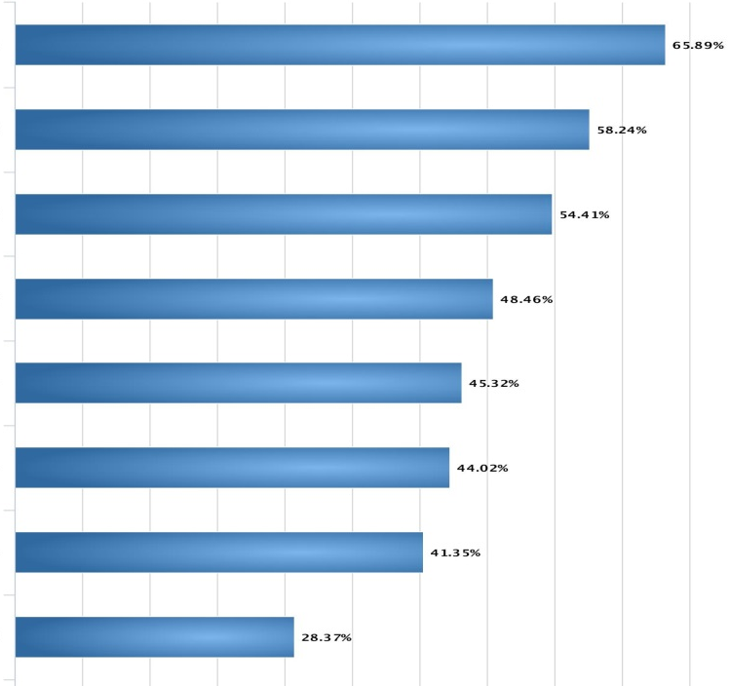
Open Public Consultation
Transformation Health and Care in the Digital Single Market
1464 responses from 35 countries
Risk of privacy breaches
Heterogeneity of electronic health records
Cybersecurity risks
Data quality and reliability
Lack of infrastructure
Legal restrictions in member states
Lack of awareness
Lack of interest
"What are major barriers to electronic sharing of health data?"
Notes:
And when we asked what the EU should do to overcome barriers to access and sharing of data, the top four actions were:
Develop standards for data quality and reliability
Standardise electronic health records
Propose health-related cybersecurity standards, and
Support interoperability with open exchange formats

Slide 4
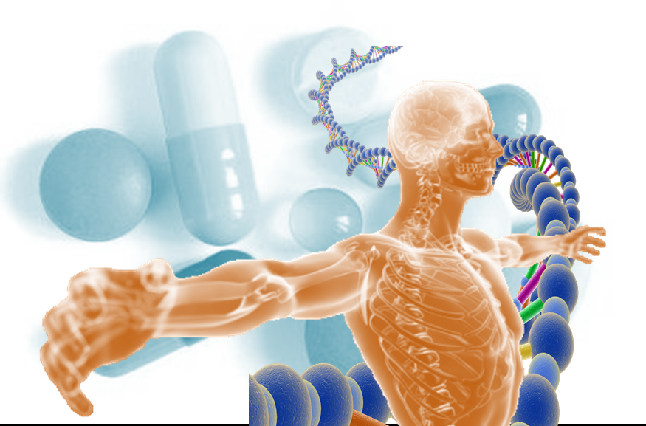
KEY ENABLING CONDITIONS: DATA PROTECTION & SECURITY & PRIVACY
Transformation Health and Care in the Digital Single Market
GDPR
NIS
ePrivacy
Europe's opportunity for citizens, health and care providers and industry: Digital Transformation of health and care built on trust
Notes:
All our efforts in the Transformation of Health and Care in the DSM must be based and trust.
Trust will be gained through compliance with NIS and GDPR
Because of NIS and GDPR we get the Trust

